Slide 1
SF World day
2019

Slide 3
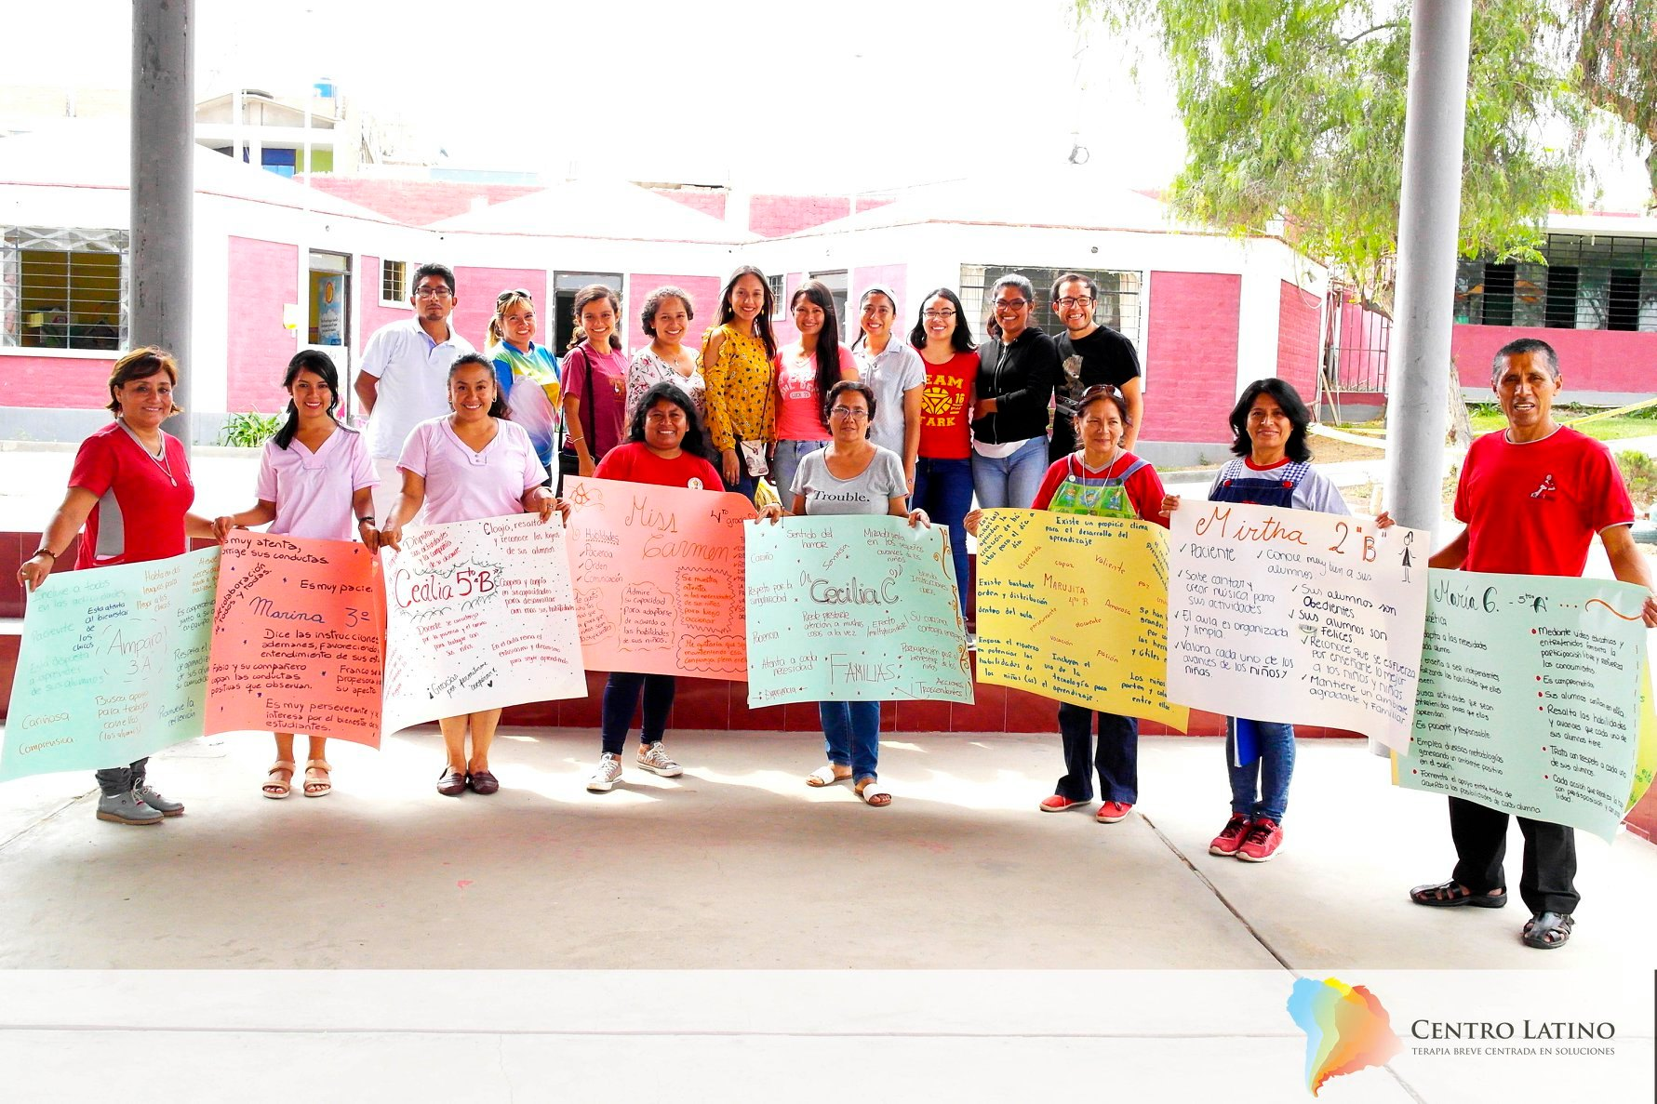
This is how we enjoyed May 03th... in Trujillo, Peru

Slide 4
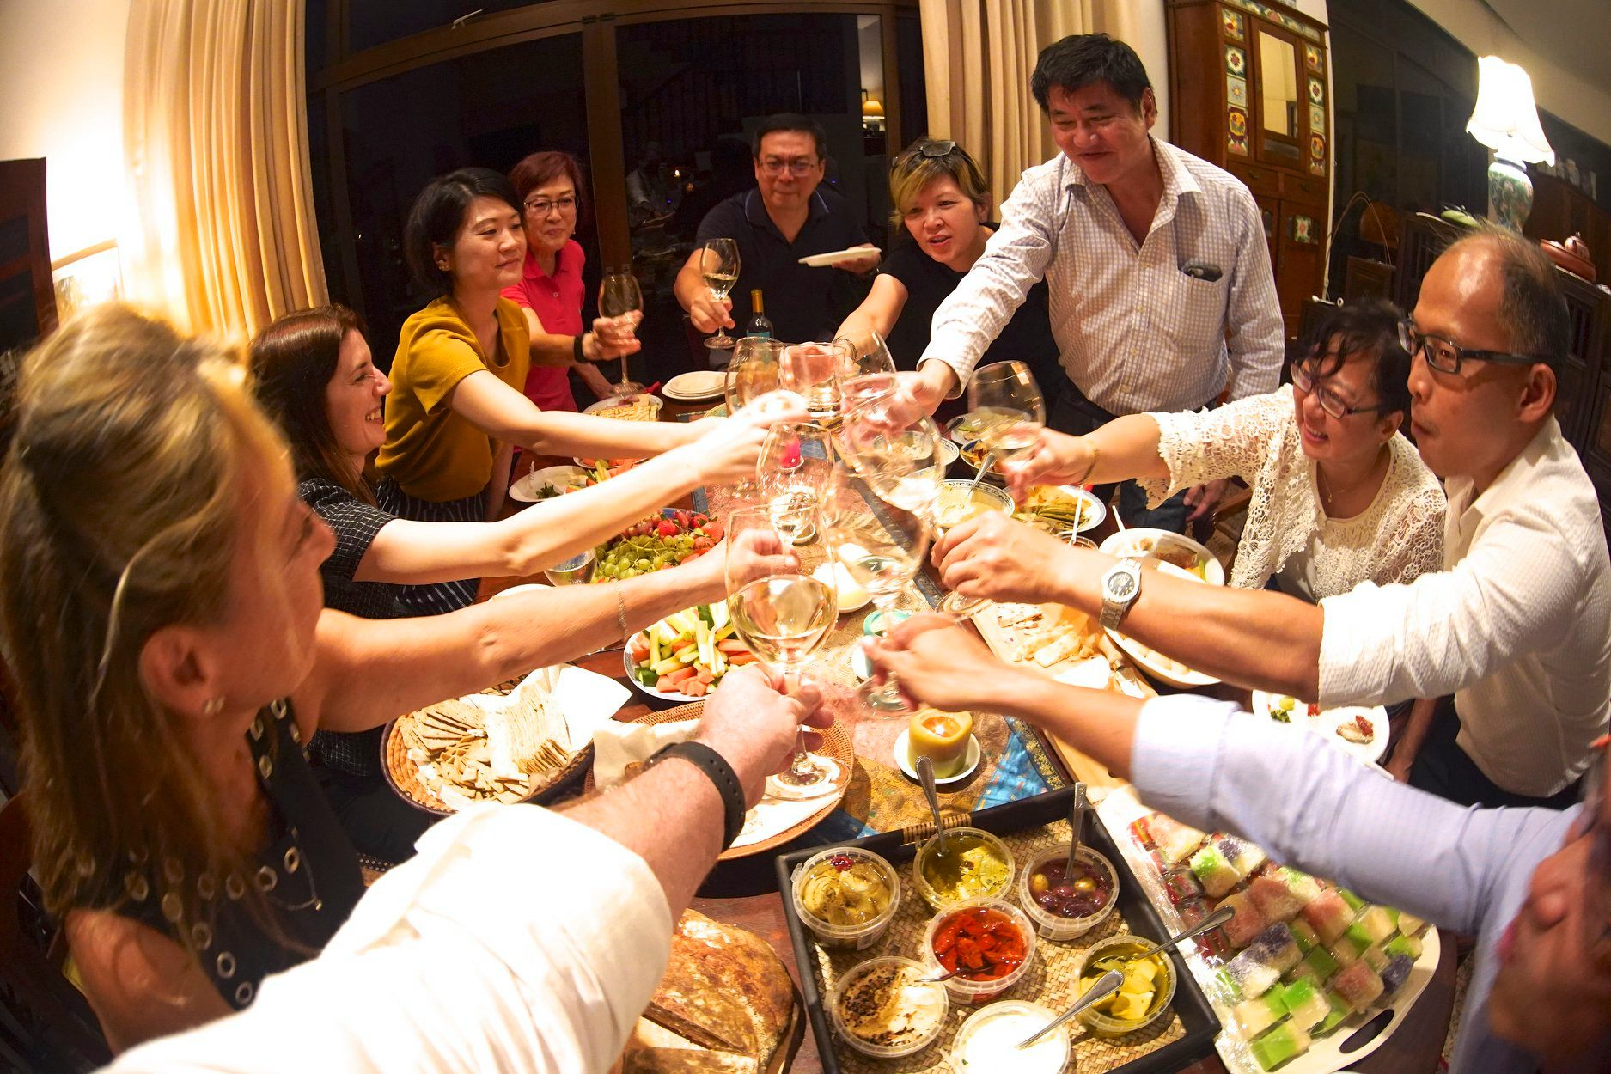
2019 SF World Day was celebrated with Gusto in Singapore! We shared a zoom link with Kirsten and recorded our big toast, Singapore style with a big "Yam Seng". We read excerpts from Steve's paper on "The Death of Resistance", quite radical then and still quite radical today. We'd like to share highlights from this magical day with our global SF colleagues and friends!

Slide 5
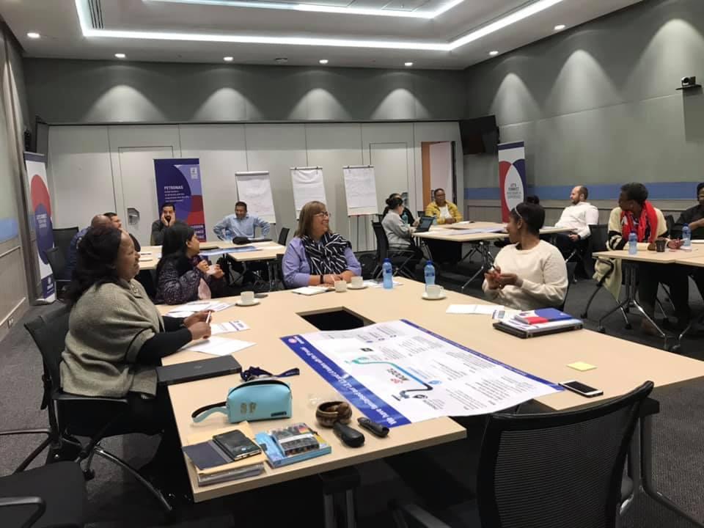
Creating SF ripples from Singapore to Malaysia to S. Africa.....celebrated SF World Day with a Client in Cape Town yesterday.

Slide 6
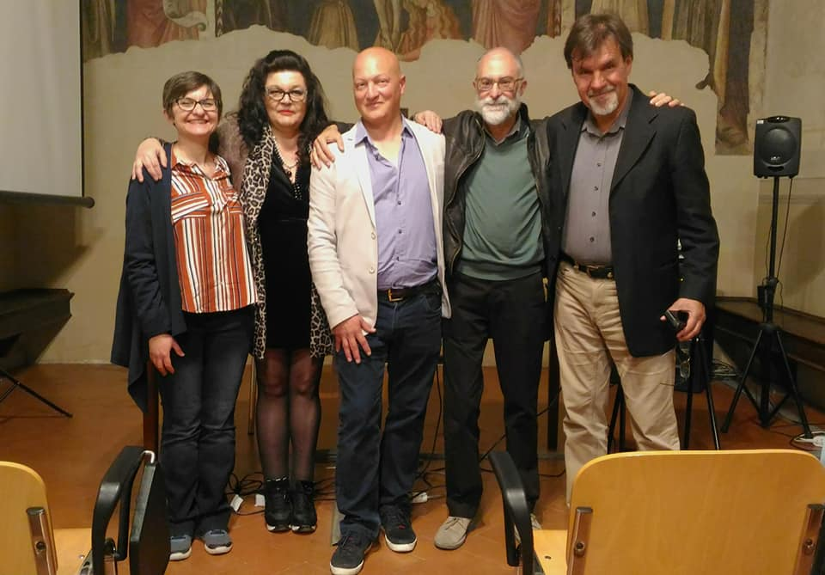
Greetings from Florence!

Slide 7
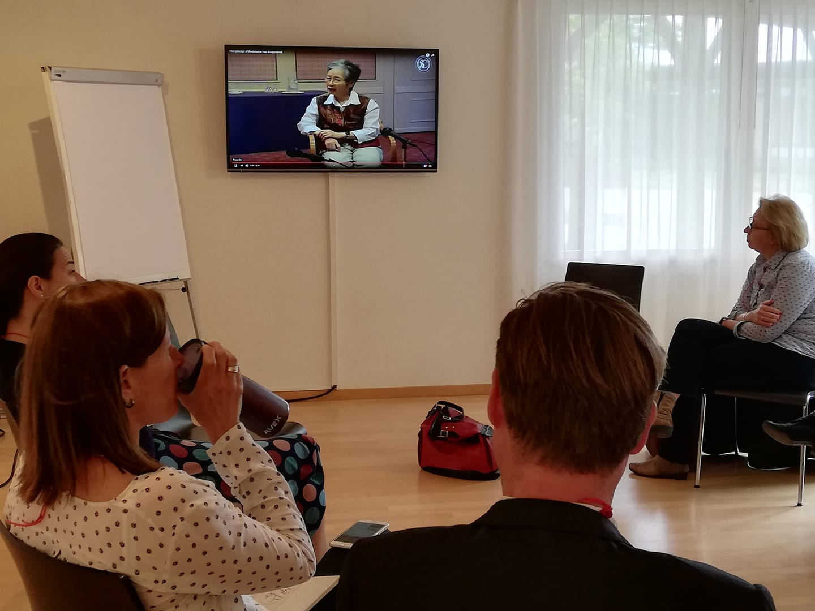
Thank you Arnoud Huibers! Open space workshop "resistance revisited" with Insoo! #expeditionlösung #sfworldday #sfontour

Slide 8
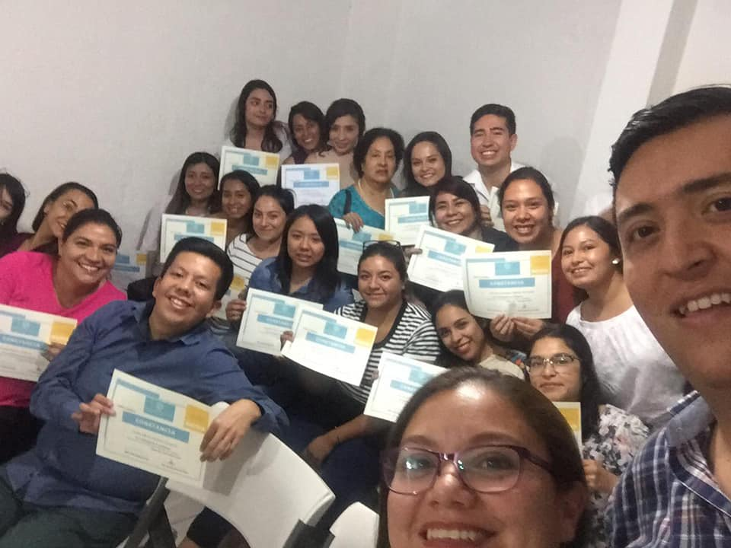
Mexico present at the celebration!!

Slide 9
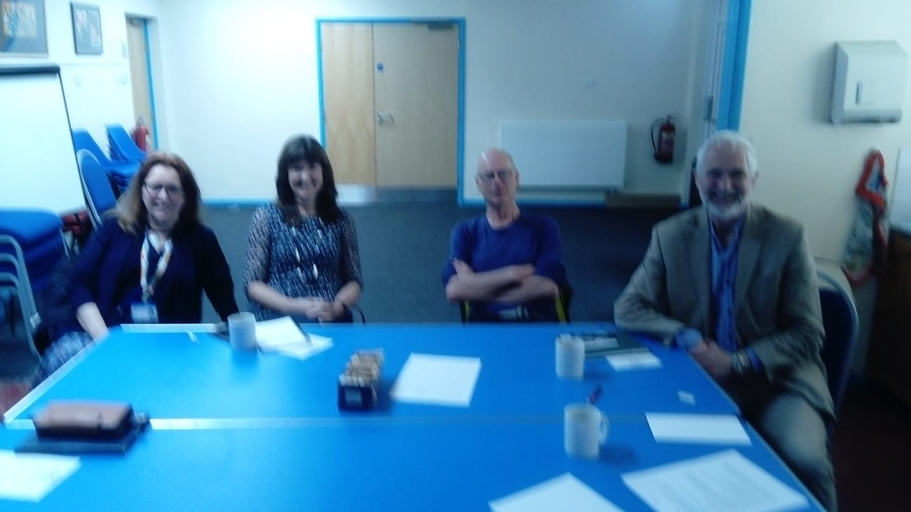
Enjoying great opportunities today. Watched Ann-Marie's greeting from Ibstanbul. Shared our own fascinating examples from practice. Watched the interview with Luc, watched the end of the workshop in South Africa, discussed our reactions to Arnoud Huibers interview with Insoo. Played Jos Kienhuis board game and looked enviously at the food being prepared in Singapore. So many treats to chose from. Thank you SF community.

Slide 10
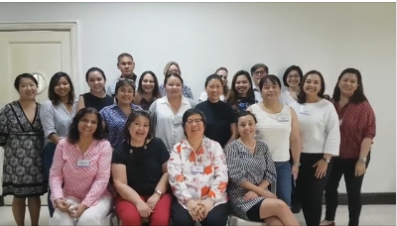
SF Manila family greeting everyone .. during our SF Level 1 Training May 2-4,2019 at In Touch Community Services, Manila Philippines.

Slide 11
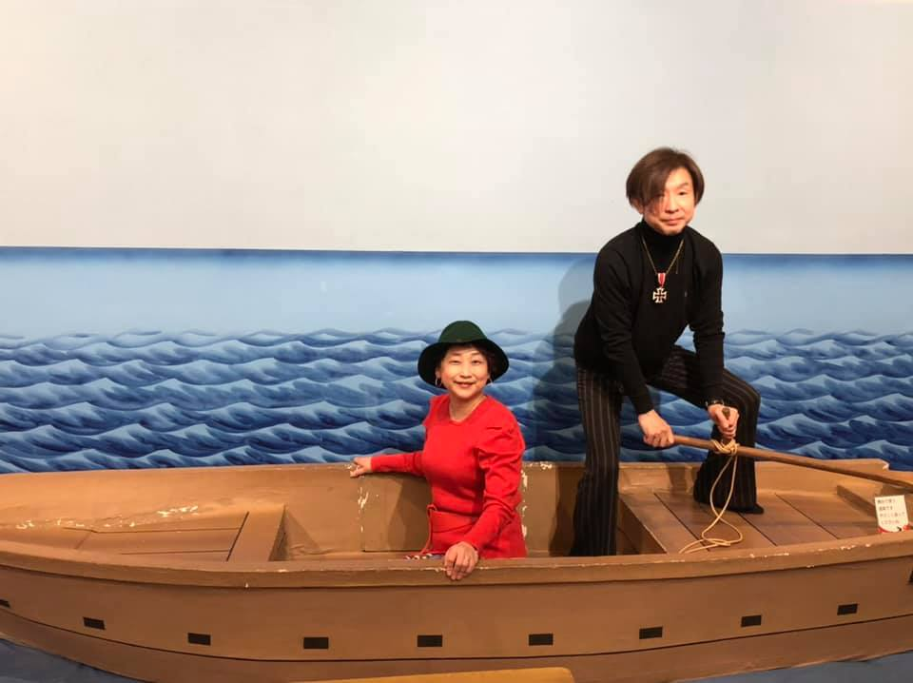
Happy SF World Day from JAPAN🎊
SFA has changed everything about my life not only therapy but private one.
Many thanks to Insoo & Steve.
Hope SF friends have happy SF life.
May Solution be with you

Slide 12
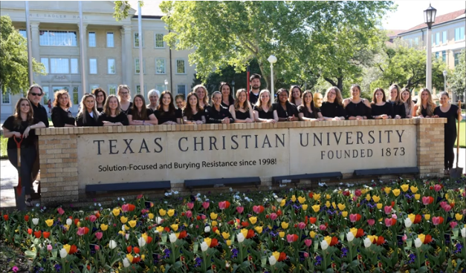
Happy Solution-Focused World Day 2019 from all of us at the TCU Counseling Program! Texas.USA.

Slide 13
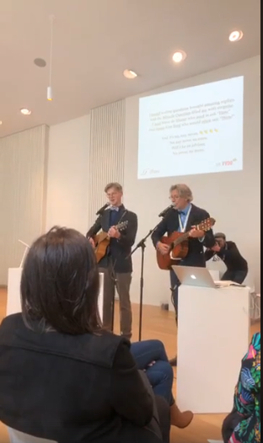
Anton and Geert sharing the Adviser song with a gathering of over 100 in Gent in Belgium

Slide 14
Overview
People from many countries around the world connected with each other, including Singapore, South Africa, Poland, Italy, UK, USA, Chile, Belgium, Peru, Switzerland, China, Slovenia, Mexico, Philippines, Japan, Finland, Canada, Greece, Cambodia, Turkey, Denmark, Germany, New Zealand, Bolivia, Sweden, Russia and the Netherlands. In many of these countries practitioners had also gathered together to mark the day with a gathering in Gent attracting over 100 exuberant practitioners.

